Slide 1
2020-21 NFHS Softball
DP/FLEX

Slide 2
Comparing the DP/FLEX to other lineup positions
Visual representations of each player's “job”

Slide 3
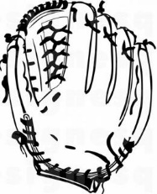
Typical players
Usually each position in the lineup has a player that:
Plays Offense (bats and runs)
Plays Defense (uses their mitt)
Notes:
Adding the visual bat and glove for use later to help visual learners. Note the “regular” player bat and glove are different from the DP/FLEX on the next slide.

Slide 4
DP/FLEX Splits these two Functions
DP is the offensive specialist:
As long as the DP plays offense, they have not left the game (uses their bat)
FLEX is the defensive specialist:
As long as the DP plays defense, they have not left the game (uses their mitt)
Notes:
This is a visual representation to help visual learners understand how DP/FLEX share a single players responsibilities.

Slide 5
Visual of bat and mitt only for Training/understanding DP/FLEX
The graphics of the bat and mitt are only to aid in understanding the DP/FLEX roles during this presentation:
Bat represents playing offense (batting and running)
Mitt represents playing defense
It is not intended to imply that the DP must physically use the FLEX’s mitt if playing defense for them
Nor does it mean the FLEX has to use the same bat used by the DP if they play offense for the DP
These graphics are not intended to be used, or marked on the actual lineup card during the game

Slide 6
Looking at the DP/FLEX by the rules

Slide 7
DP/FLEX Rule 3-3-6
DP/FLEX Rule allows for more participation and flexibility in the game
Gives coaches an option:
not to use the DP/FLEX at all, or
use the DP/FLEX option to its fullest extent
www.nfhs.org

Slide 8
DP/FLEX rule 3-3-6
The DP/FLEX does not have to be used.
If used it must be noted on the starting lineup card.
Once a team starts the game with the DP/FLEX on their lineup card, those positions are available for the entire game
As with all players they only have one reentry, but the position is always available for an eligible substitute to enter that position
There is no difference with the DP/FLEX positions they are available the entire game
www.nfhs.org
Notes:
Highlighting the position (DP or FLEX) are always available for an eligible sub to enter, even if the starting player has used their reentry and left the game again, that player is done for the game but the position is still available for a sub to enter.

Slide 9
DP/FLEX rule 3-3-6
A team using the DP/FLEX starts the game with 10 players in the lineup but could end with 9 or 10 players in the lineup.
They would have 10 players if both the DP and FLEX positions have players active at the end of the game
There would only be 9 players if:
The DP is playing defense for the FLEX (FLEX has left the game)
FLEX is playing offense for the DP (DP has left the game)
www.nfhs.org

Slide 10
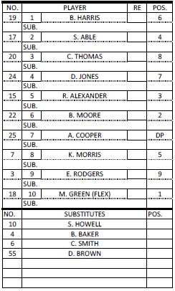
THE LINEUP CARD
The DP is the offensive player (uses their bat) and must remain in same batting position for the entire game.
The name of the player for whom the DP is batting (FLEX) will be placed in the No. 10 position in lineup and they will play defense (uses their mitt).
www.nfhs.org
Notes:
This slide contains several “layers” of the lineup card that can only be seen when the slide show is being viewed.

Slide 11
The lineup card
The DP position always remains an option for use in the lineup, as long as there are eligible substitutes
A starting or substitute DP may re-enter one time, as long as they return to the original position in the batting order
www.nfhs.org

Slide 12
Substituting for the dp
The DP (player) may be replaced by:
Pinch-runner
DP (position) is still active
Pinch-hitter
DP (position) is still active
Substitute
DP (position) is still active
FLEX
DP (position) is no longer active
In all cases, the DP (player) has left the game, with one re-entry permitted.
www.nfhs.org

Slide 13
SUBSTITUTING FOR THE DP
This is no different than a substitution for any other player/position in the lineup!
Baker pinch-runs for Cooper
Cooper has left the game and has a re-entry remaining
4
Baker
Baker is now the DP playing offense (using the bat)
www.nfhs.org
Notes:
This slide contains several “layers” of the lineup card that can only be seen when the slide show is being viewed.

Slide 14
THE FLEX MAY PLAY OFFENSE
Drawing this arrow from the FLEX position up to the DP position leaves no doubt who is playing offense in the DP’s position.
If the FLEX bats or runs for the DP, the DP leaves the game
The FLEX (Green) is now batting in the No. 7 position (Still has their mitt and now uses the bat too)
Lineup is down to nine
www.nfhs.org
Notes:
Any player may re-enter once.
This slide contains several “layers” of the lineup card that can only be seen when the slide show is being viewed.

Slide 15
THE DP RE-Enters
Drawing this arrow shows that the FLEX went back to playing defense only.
The DP (Cooper) re-enters to bat or run (takes their bat back)
The FLEX (Green):
Returns to the No. 10 position in the lineup
Plays defense only
Has never left the game (never gave up their mitt)
www.nfhs.org
Notes:
Any player may re-enter once.
This slide contains several “layers” of the lineup card that can only be seen when the slide show is being viewed.

Slide 16
Why would a coach want to do this?
Gives them the option to have the FLEX bat and the DP re-enter to run for them
If the FLEX is no longer the pitcher or catcher later in the game
They could bat for the DP
Once on base the DP re-enters to run for them
When the 7th spot in the lineup is reached, the FLEX can again bat for the DP
Once on base an eligible substitute can be entered for the DP position and the FLEX goes back to defense only
This can be repeated as many times as there are eligible subs to enter the DP position to run for the FLEX
During all this time the FLEX never leaves the game (they continue to use their mitt)

Slide 17
The dp may play defense
The DP may play any defensive position, for any player
If the DP plays defense for the FLEX, the FLEX has left the game (no longer using their mitt)
If the DP plays defense for a player other than the FLEX, that player still bats and has not left the game
www.nfhs.org

Slide 18
THE DP Playing DEFENSE FOR THE FLEX
Cooper begins to pitch (takes Green’s mitt)
1
Green has left the game (no longer using their mitt)
Lineup is down to nine
Green may re-enter once
www.nfhs.org
Notes:
This slide contains several “layers” of the lineup card that can only be seen when the slide show is being viewed.

Slide 19
THE DP playing DEFENSE not for the flex
Cooper plays second base and still bats No. 7 (takes Abel’s mitt)
4
Able no longer plays defense but still bats No. 2
Able has not left the game
www.nfhs.org
Notes:
This slide contains several “layers” of the lineup card that can only be seen when the slide show is being viewed.

Slide 20
Why would a coach want to do this?
Allows them to rest a player that might be slightly injured without having to remove them from the game
If a runner slides into the second baseperson and she has a sore calf, the DP can play defense for her for an inning and let her ice down her calf
Allows a player to warm up to enter as pitcher
If the backup pitcher is playing second base, the DP can play defense for them
That player can then warm up to be ready to enter as the pitcher without having to leave the game and use a reentry when they enter to pitch
After warming up they can become the pitcher and the DP can go back to playing offense only
In both cases the slightly injured player, the DP and the player warming up have not had to leave the game

Slide 21
Illegal substitution
Since the DP and FLEX split the offensive and defensive jobs of one player, they are “tied together” or “linked” and the FLEX can only play offense for the DP
The FLEX may not go into one of the first nine positions for someone other than the DP
If they do, an illegal substitution results
www.nfhs.org

Slide 22
Key points
The DP/FLEX positions are never terminated
A team may go from 10 to 9 players and back to 10 any number of times during the game, as long as they have eligible substitutes
The game may end with 10 or 9 active players
www.nfhs.org

Slide 23
Easy reminders
The DP can never be on defense only:
If they don’t play offense (use their bat) they have left the game
The FLEX can never be on offense only:
If they don’t play defense (use their mitt) they have left the game
www.nfhs.org

Slide 24
Easy reminders
The DP and the FLEX can never be on offense at the same time:
They are tied together and only one player can play offense in their (DP’s) position in the lineup
The DP and the FLEX can play defense at the same time;
FLEX can keep using their mitt and the DP can use someone else's
www.nfhs.org

Slide 25
DP/FLEX RULE
SAMPLE EXERCISES
www.nfhs.org

Slide 26
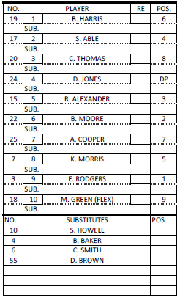
SAMPLE LINEUP CARD
All samples will use this lineup card and progress through a series of substitutions
www.nfhs.org

Slide 27
Sample exercise #1
Jones (DP) bats and gets on base safely
The offensive coach asks for time to make a change
“Green will run for Jones"
www.nfhs.org

Slide 28
SAMPLE EXERCISE #1
Green (FLEX) running for Jones (DP)
www.nfhs.org
Notes:
This slide contains several “layers” of the lineup card that can only be seen when the slide show is being viewed.

Slide 29
Sample exercise #1
Note –
Jones has left the game (no longer playing offense), they still have one re-entry. Green is now playing offense and defense.

Slide 30
Sample exercise #2
Two innings later, Green singles to left
The offensive coach asks for time to make a change
"Smith is running for Green and Green will still be playing right field”
www.nfhs.org

Slide 31
Sample exercise #2
Note –
This substitution is critical for the umpire to ensure they understand what the coach is requesting
Coach says “Smith is running for Green” at this point there are two options:
Smith is substituting for Green and is the new FLEX playing offense in the DP’s position in the lineup. Change is made and recorded in the 10th position
Smith is substituting for Jones and is the new DP, Green is going back to playing defense only. Change is made and recorded in the 4th position.
By actively listening and understanding the second part of the coach's statement “Green will still be playing right field” we know the coach wants option 2.
www.nfhs.org

Slide 32
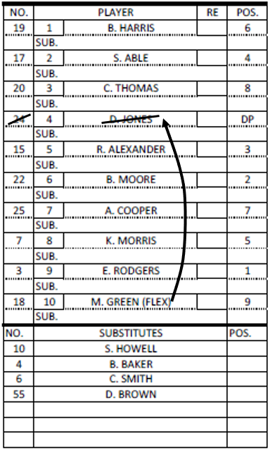
SAMPLE EXERCISE #2
Smith (sub) running for Green (FLEX) is recorded as a sub for Jones and becomes the new DP
Green remains in the game playing right field only
6
Smith
DP
www.nfhs.org
Notes:
This slide contains several “layers” of the lineup card that can only be seen when the slide show is being viewed.

Slide 33
Sample exercise #2
Note –
Since Green will continue to play defense, Smith enters the game for the first time as the new DP
Since Green (FLEX) is still playing defense they have NOT left the game (never quit using their mitt)
www.nfhs.org

Slide 34
Sample exercise #3
In the 4th inning, the offensive coach asks for time to make another change
“Jones to re-enter and bat for Smith”
www.nfhs.org

Slide 35
SAMPLE EXERCISE #3
6
Smith
DP
Jones (starting DP) re-enters for Smith
www.nfhs.org
Notes:
This slide contains several “layers” of the lineup card that can only be seen when the slide show is being viewed.

Slide 36
Sample exercise #3
Note –
Jones has used her re-entry
Smith has left the game and has a re-entry remaining
This is no different than a substitution/re-entry anywhere else in the lineup
www.nfhs.org

Slide 37
Sample exercise #4
In the next half inning, the defensive coach asks for time to make another change
“Jones will play defense in center field for Thomas”
www.nfhs.org

Slide 38
SAMPLE EXERCISE #4
8
6
Smith
DP
Jones (DP) to play defense in center field for Thomas
www.nfhs.org
Notes:
This slide contains several “layers” of the lineup card that can only be seen when the slide show is being viewed.

Slide 39
Sample exercise #4
Note –
Jones the DP is now playing offense (using their bat) and defense (using Thomas’ mitt)
Thomas still bats in the 3rd position in the lineup is playing offense only (still using their bat) and has NOT left the game
www.nfhs.org

Slide 40
Sample exercise #5
In the next inning, the defensive coach asks for time to make another change
“Thomas is going back to playing center field, Jones will play defense in right field for Green”
www.nfhs.org

Slide 41
SAMPLE EXERCISE #5
8
9
8
Thomas goes back to center field
Jones (DP) to play defense in right field for Green (FLEX)
6
Smith
DP
www.nfhs.org
Notes:
This slide contains several “layers” of the lineup card that can only be seen when the slide show is being viewed.

Slide 42
Sample exercise #5
Note –
Jones (DP) is still playing offense and defense (now using the FLEX’s mitt)
Green (FLEX) has left the game (still has a re-entry) since she is not playing defense (no longer using their mitt)
www.nfhs.org

Slide 43
Thank You
National Federation of State High School Associations PO Box 690 | Indianapolis, IN 46206 Phone: 317-972-6900 | Fax: 317.822.5700 www.nfhs.org | www.nfhslearn.com | www.nfhsnetwork.com

