Slide 1
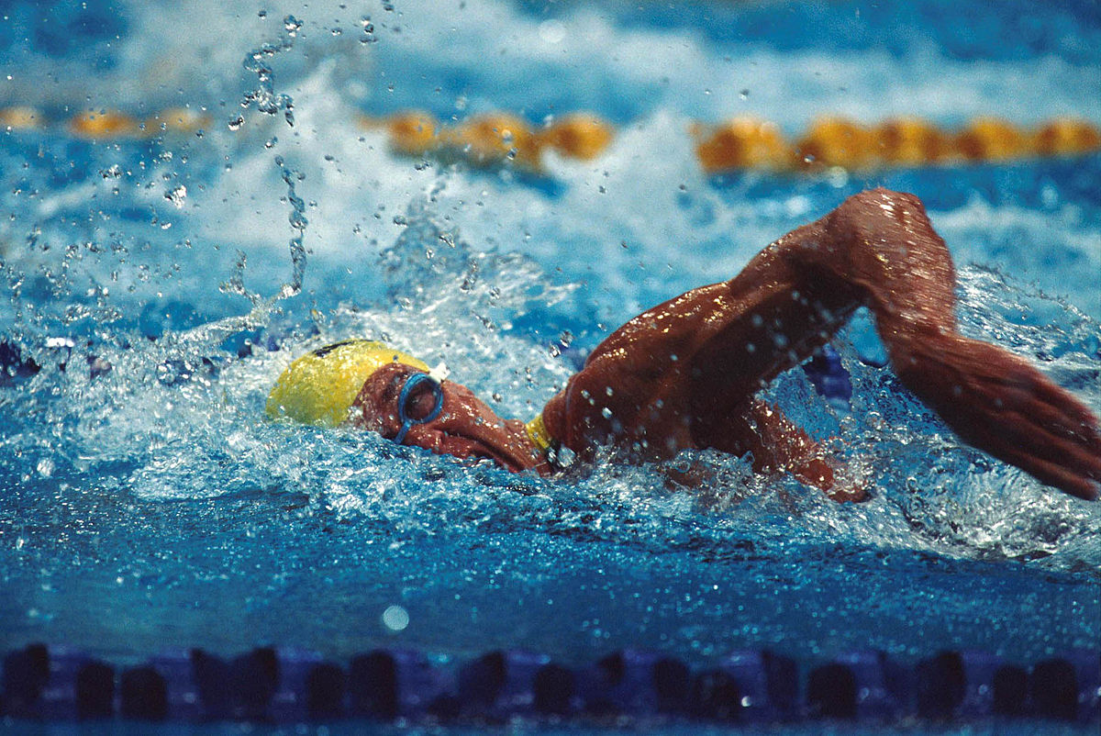

2022-23
WVSSAC Swim Rules Clinic

Slide 2

CONTACT INFORMATION
Cindy Daniel, Ed.D., Assistant Executive Director
304-485-5494 (O) or 304-552-7866 (C)
cindy.daniel@wvssac.org
Scott Wilson, Rules Interpreter
sewjd@aol.com

Slide 3
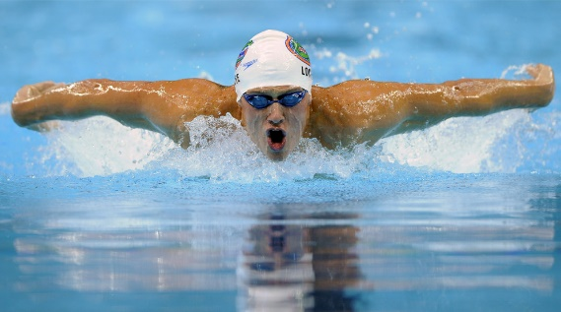
WELCOME
PLEASE MAKE SURE TO COMPLETE THE ATTENDANCE CARD. TEAR OFF THE BOTTOM PORTION OF THE CARD AND KEEP FOR YOUR RECORDS.
PLEASE SILENCE ALL CELL PHONES.

Slide 4

REQUIRED READING
Interscholastic
Swim Coaches’ Packet
Sports Medicine Coaches’ Packet
NFHS Swim Rule Book (sent to schools)
Officials’ Packet
Access the documents at www.wvssac.org – click on “Sports” tab, then “Swim”

Slide 5

REQUIRED ONLINE COURSES
Concussion In Sports (annually)
Sudden Cardiac Arrest (annually)
Heat Illness Prevention (one time for new coaches)
All courses are free and can be accessed on the WVSSAC homepage (www.wvssac.org)

Slide 6
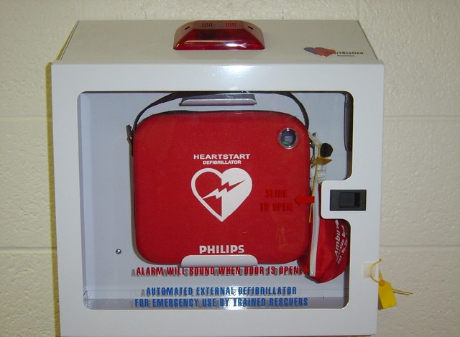
AED REQUIREMENT
An AED is required at all practices and contests.
Coaches required to be trained in AED/CPR.

Slide 7
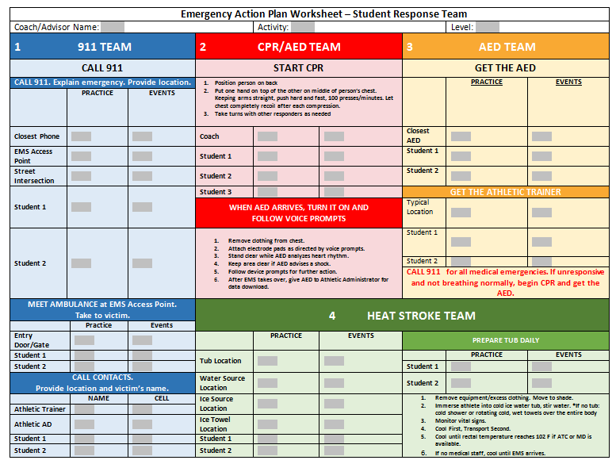
REQUIRED – Emergency Action Plan
ALL schools must complete an Emergency Action Plan annually BEFORE THE FIRST DAY OF PRACTICE. Please work with your athletic director and school administrators to make sure it is completed.
Fines up to $250 if not completed by first day of practice.
EAP must be posted!

Slide 8
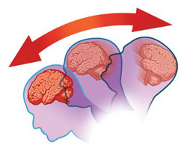
CONCUSSION REPORT FORM
Schools must submit an online concussion report WITHIN 7 days of the incident for any athlete who is removed from practice or play with a suspected concussion/head injury. Form is on our website.

Slide 9
CONCUSSION RTP PROTOCOL
RTP shall be delayed until the athlete is asymptomatic and has undergone a progression of tests to determine if they are able to RTP. Each step/test in the progression takes 24 hours and no more than one progression per day may be completed.
If any symptoms occur during the progression, the athlete should rest for 24 hours before attempting the same progression again.
No activity with complete physical and cognitive rest.
Light aerobic exercise (less than 70% of maximum heart rate).
Sport specific exercise (drills specific to the athlete’s sport).
Non-contact training drills (more intense sport drills with no contact from other players).
Full contact practice (following medical clearance).
Return to play (normal game play).

Slide 10

Approved Health Care Providers Who Can Evaluate and Release to RTP
  Medical Doctor (MD)
  Doctor of Osteopathy (DO)
  Doctor of Chiropractic (DC)
  Advanced Registered Nurse Practitioner (ARNP)
  Physician Assistant (PA-C)
  Licensed/Registered Certified Athletic Trainer (ATC/R, LAT, ATC)
  Licensed Physical Therapist

Slide 11
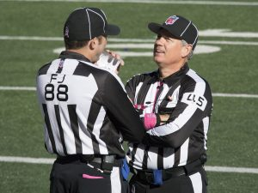
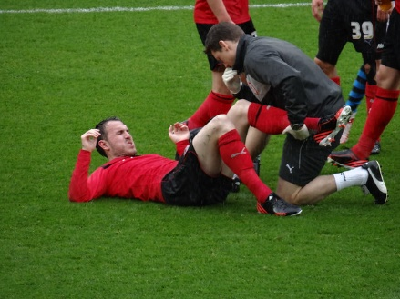


Medical Time Out
Short, pre-game meeting so that everyone knows what emergency personnel, supplies, and equipment are on site and available in case of an emergency.
Athletic trainer responsible for the meeting. If no athletic trainer is present, head coach of home school is responsible.
Refer to Sports Medicine Packet for more information.

Slide 12

NEW HEAT ILLNESS POLICY
The policy applies to all practice and conditioning activities (in season, out of season, summer) in which heat illness poses a risk, both outdoor and indoor.
Prevention:
Coaches will be notified of any student athlete with pre-existing conditions that place the individual at higher risk of exertional heat illness
Monitoring:
Monitoring will occur at the beginning of each practice or conditioning session, and continue every 30 minutes during the activity, using a Wet Bulb Globe Thermometer (WBGT) device. The monitoring will be recorded either in a hard copy or stored in the device. Modifications will be made as follows:

Slide 13
NEW HEAT ILLNESS POLICY
WBGT Reading | Activity Guidelines/Modifications
Under 82.0 | Normal activities. Provide at least three separate rest breaks each hour with a minimum duration of three minutes each during the workout.
82.0-86.9 | Use discretion for intense of prolonged exercise; watch at-risk players carefully. Provide at least three separate rest breaks each hour with a minimum duration of 4 minutes each.
87.0-89.9 | Maximum practice time is 2 hours. For football: players are restricted to helmet, shoulder pads, and shorts during practice, and all protective equipment must be removed during conditioning activities. If the WBGT rises to this level during practice, players may continue to work out wearing football pants without changing to shorts. For all sports: Provide at least four separate rest breaks each hour with a minimum duration of 4 minutes each.
90.0-92.0 | Maximum practice time is 1 hour. For football: no protective equipment may be worn during practice, and there may be no conditioning activities. For all sports: There must be 20 minutes of rest breaks distributed throughout the hour of practice.
Over 92.0 | No outdoor workouts. Delay practice until a cooler WBGT level is reached.

Slide 14

NEW HEAT ILLNESS POLICY
Monitoring of student athlete safety will be continuous during any physical activity. School staff should be educated on the signs and symptoms of exertional heat illness. The signs and symptoms include, but are not limited to:
Headache, confusion or “out of it” look, disorientation, or dizziness, altered consciousness or coma, nausea or vomiting, diarrhea, hot and moist or dry skin. A rectal temperature greater than 104 F at time of incident indicates exertional heat stroke.

Slide 15

NEW HEAT ILLNESS POLICY
If a student athlete is suspected of having exertional heat stroke, EMS must be called immediately. However, anyone with exertional heat stroke must be COOLED FIRST and then transported by EMS.
A cooling zone must be designated at each practice site. Treatment must include minimum:
-Removing excess clothing
-Placing patient in a cold-water immersion tub (35-59 F), or ice floating on top of tub if no thermometer available to check water temperature
Once diagnosed with exertional heat illness, the student athlete must complete a rest period and/or obtain medical clearance from a physician before returning to play, depending on the type of illness diagnosed.

Slide 16
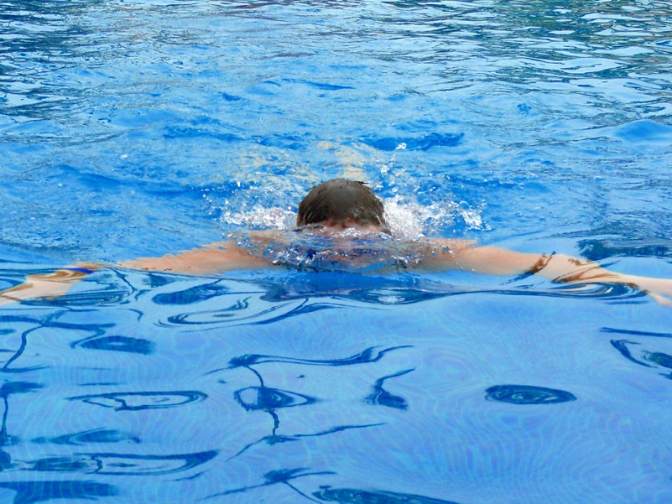
Other Important Information
Non School Participation Rule
12 days of practice with the school team before first contest
Use of Pool – If 2 or more schools are using same pool – letter requesting permission. Keep separate.
Eligibility
Physical exams – parent and student signature

Slide 17

Non School Participation Rule 127-2-10
Swim is exempt provided that:
  Participation is approved by the principal
  The student misses no school sponsored contest involving that sport
  A student who violates this rule will be ineligible for participation in that sport for the remainder of the season.
  Note – 10.2.e – USA Swimming Junior National Championship

Slide 18
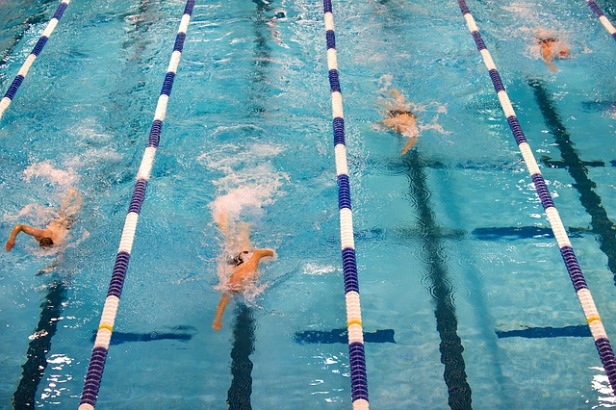
Out of Season Coaching
3 week window
Flex Days – 12
Cannot work with students in grade span coached or one grade below in swim

Slide 19

NEW WVSSAC RULES
29 New Rules – Several were editorial
Age – 15 for MS, 19 for HS before July 1
Semester/Season – Six consecutive semesters after starting 6th grade
International Students (Not through foreign exchange program) – JV only
Three -week period – may be by school if approved by county BOE
Robotics – now a WVSSAC sanctioned activity

Slide 20
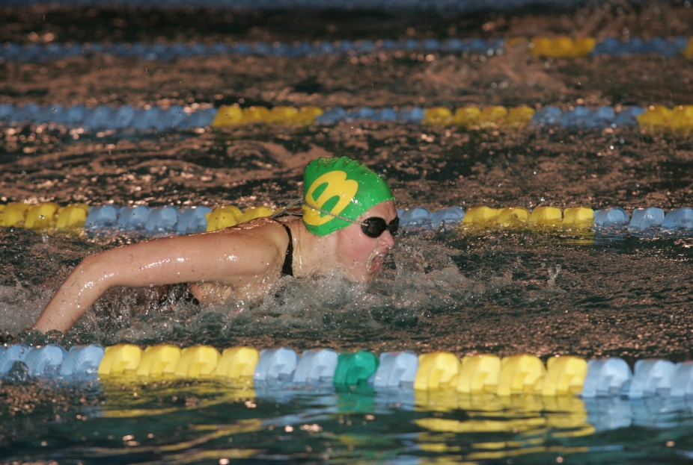

SEASON DATES
First Practice: October 24
First Contest: November 9
Regional: February 4
State: February 16-17
Regional Entry Form due – January 31 - NOON

Slide 21
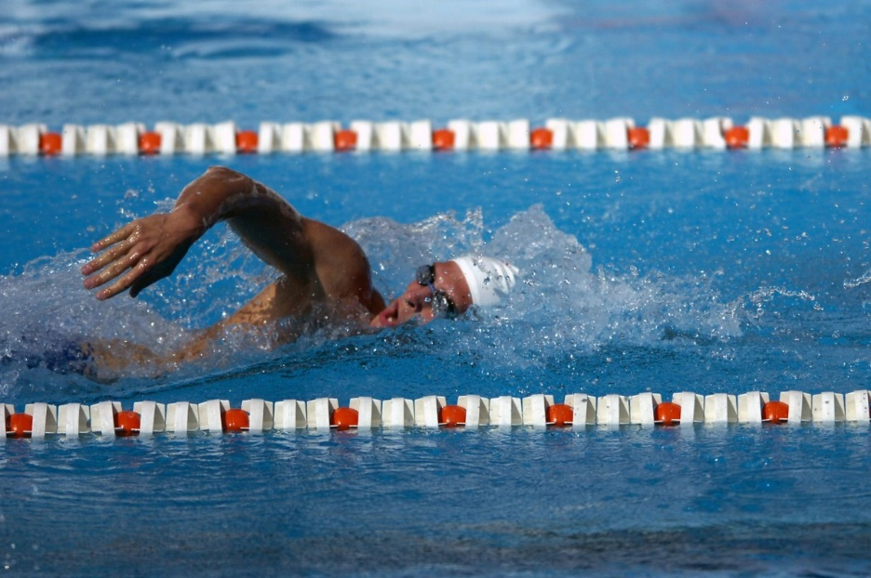
Regional Sites
Region 1 – Brooke HS
Region 2 – Fairmont State University
Region 3 – The Bridge
Region 4 – Marshall University

Slide 22

New Sanctioning Rules
Intrastate
Interstate
No sanctioning required.
Must play legal opponent (Refer to 127-3-12)
Any interstate event in which four or more schools participate and at least one of the states participating requires sanctioning.

Slide 23
REMINDERS
Entries are to be submitted using HyTek
Individual Entry Times (for regular season meets)
  Must be from high school meets (current or prior season)
Relay Entry Times
  Must be from high school meets from current season
Breaks during state meet – not less than (5) minutes
500 Freestyle qualifying times
  7:30.00 Women
  6:30.00 Men

Slide 24
Reminders – (Continued)
Hy-tek entries – Due January 31 by noon to both WVSSAC and regional director
Minimum meets to qualify for regionals –
  Individuals - participation in a minimum of four meets
  Teams – scheduled a minimum of six meets

Slide 25
Regional Psych Sheets
Regional directors will submit psych sheets to the WVSSAC office.
The WVSSAC office will send all psych sheets to schools by Wednesday prior to regionals.
Everyone will receive information at the same time.

Slide 26
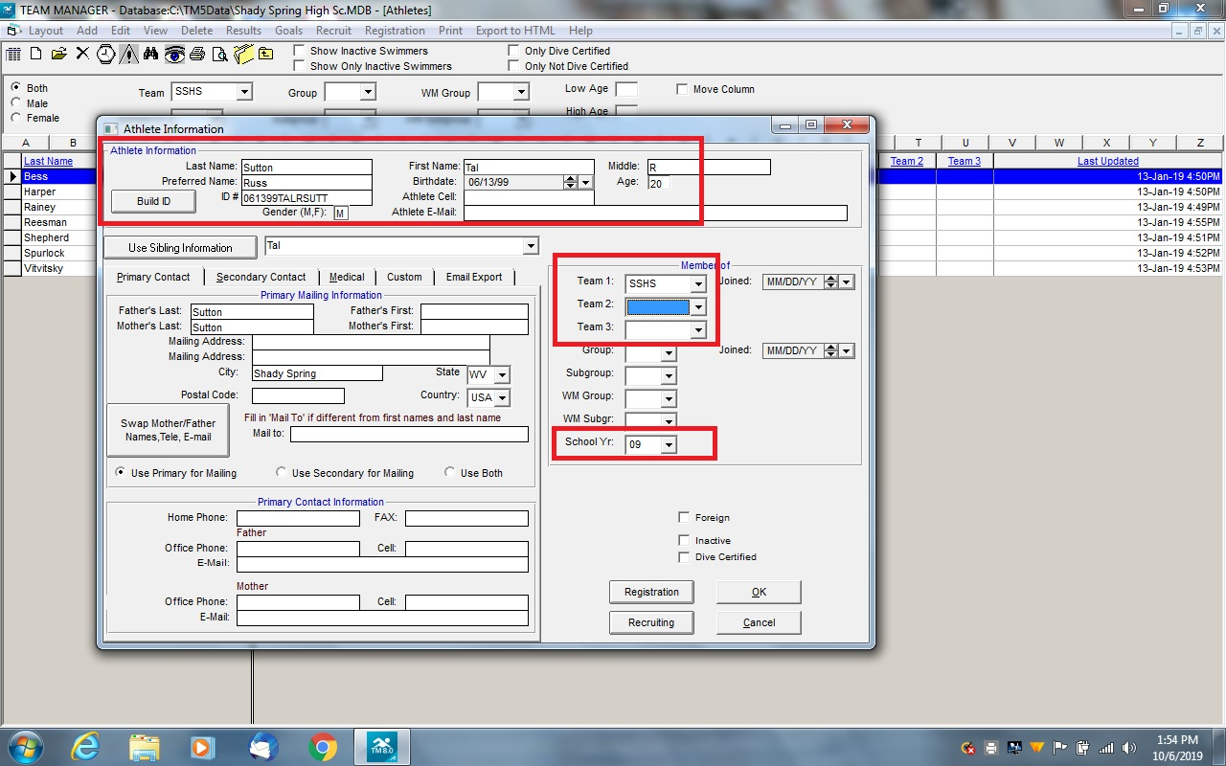

Slide 27

LEGAL DUTIES OF A COACH
Properly plan the activity
Provide proper instruction
Warn of inherent risks
Provide a safe physical environment
Provide adequate and proper equipment
Match athletes appropriately
Evaluate athletes for injury or incapacity
Supervise activity closely
Provide appropriate emergency assistance
Protect against physical and psychological harm from others

Slide 28
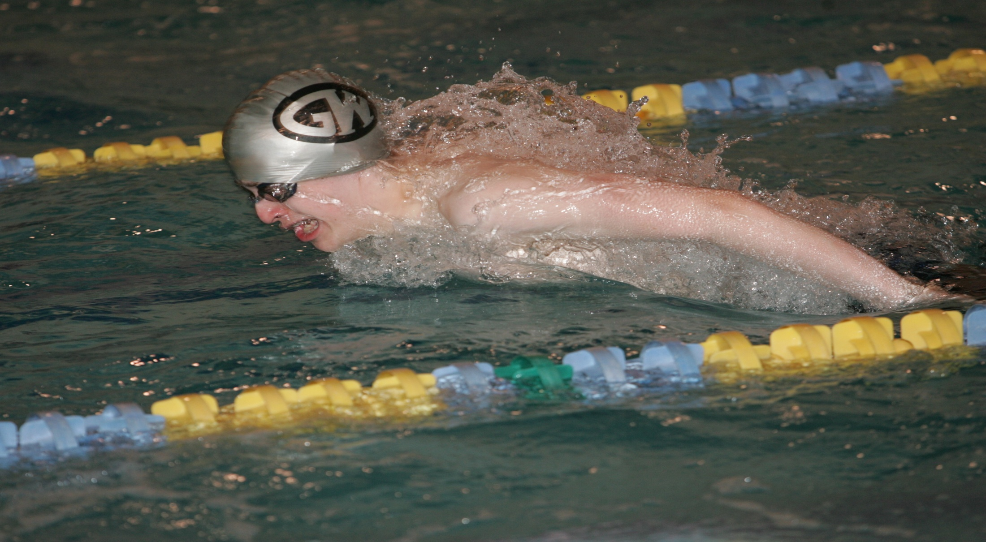
STATE QUALIFIERS
Individual Events:
  The top three (3) from each region and the remaining twelve (12) qualifiers will be the next fastest twelve (12) competitors, by time, from all regions combined.
Relays:
  The top two (2) from each region and the next 10 fastest times. This will only occur if all regionals use automatic timing. If a team qualifies 7 or more athletes, no alternate is permitted.
If a team qualifies fewer than 7 athletes (which at least one must be a relay), the coach must fill out the form and request to bring ONE alternate. (This form MUST be sent to the WVSSAC by the Monday following the regional meet.)

Slide 29
OFFICIALS
PART 1 EXAM
WVSSAC Website – www.wvssac.org
Must have an email address
OFFICIAL login
Testing window – October 3 – November 7, 2022
(minimum score 75%)
Instructions are in packet
Self nomination deadline – January 13, 2023
For any questions, contact Alice Goodwin – alice.goodwin@wvssac.org or 304-485-5494.

Slide 30
OFFICIALS PATCH
To be worn on the left breast of the official’s shirt (stitched, ironed or Velcro.)
May also have embroidered logo

Slide 31
Required Officials’ Apparel
White – golf/polo shirt, short sleeve with collar, 2-4 buttons
Navy Blue – long pants, shorts, skirts
White – athletic shoes (no sandals or crocs)
White socks
WVSSAC officials patch or embroidery only (left breast)
Change for State Meet

Slide 32
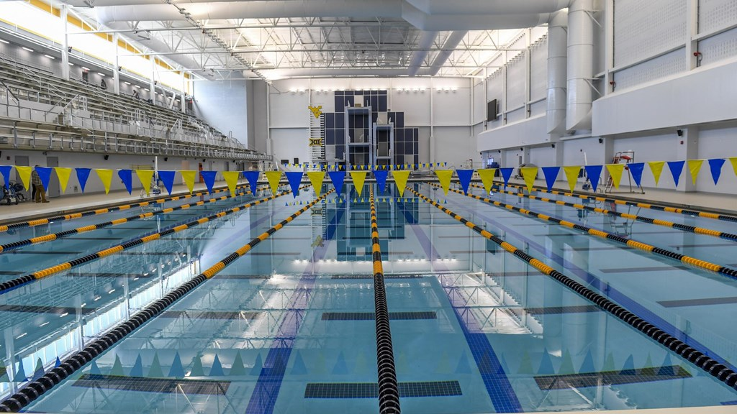
State Meet – Mylan Aquatic Center
February 16-17, 2023

Slide 33
State Meet Format
Day One
Day Two
AM – Combined prelims for events 1-12
PM – Combined finals for events 1-12
AM – Combined prelims for events 13-22
PM – Combined finals for events 13-22

Slide 34
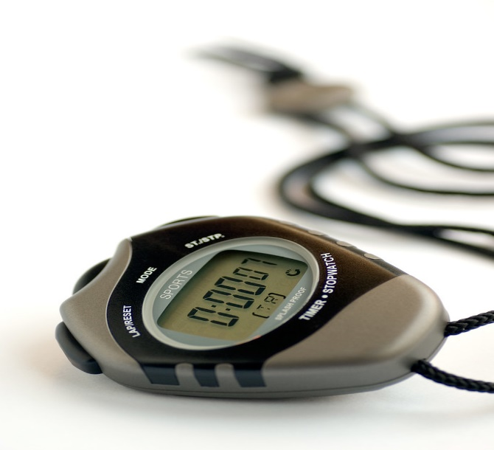
Timers for State Meet
Schools may be fined up to $50 for failure to provide timers at the state meet.

Slide 36
Swim Cloud
A great resource for swimmers in West Virginia.
Information on how to use Swim Cloud will be posted on the Swim web page.
A special thanks to Jonathan Boyd, head coach at Hurricane High School, for the information. Jonathan will be happy to answer any questions you might have. Email him at sjmbboyd@gmail.com.

Slide 37

USA Swimming Information

Slide 38

QUESTIONS? – Email Cindy or Scott

Slide 39

THANKS FOR YOUR ATTENTION!

